Slide 1

Get started with Microsoft PowerApps and Flow

Slide 2
Agenda
Module 1: Get started with Microsoft PowerApps
Module 2: PowerApps Hands-on Lab
Module 3: Get started with Microsoft Flow
Module 4: Flow Hands-on Lab
Module 5: PowerApps and Flow Hands-on Lab
Module 6: Playing with these tools

Slide 3


Module
3
Deploying, Testing and Managing BizTalk Applications
Get started
with
Microsoft
Flow
What is Flow?
Where can I use it?
Using Flow
Module
3

Slide 4
Most business integration challenges today are met with a single solution
Notes:
Human beings are actually great systems integrators today. We constantly move information around, from our phones, to our PCs, to our “data systems” that that range from a new SaaS tool, to pen and paper. We receive an input or notification on one of our devices, and we cascade it into another routine action.
Some real life examples:
Our teams are constantly meeting people at events and following up over email. We want to ensure we don't miss any of these leads, but re-typing information from emails into our CRM system is tedious.
We work with agencies who create content and upload large files to OneDrive or Dropbox accounts. Our teams want to know right when the latest files arrive, without having to check every 30 minutes, and then they want to transfer a backup to a save cloud storage as soon as it comes through to ensure we don’t loose any valuable work.
I get hundreds of emails every day, and my notification options are all-or-nothing. It’s hard to keep up with all that traffic when I’m travelling. I’d like to get an SMS when specific people like my boss or a key customer prospect reach out directly to me
However, humans aren’t especially efficient system integrators. What if we could automate these processes?
Most of these system are seen as "not designed to work with each other" and integration projects between these systems will quickly become complex IT projects that take a long time to execute and require deep integration expertise.
What if we could automate routine tasks to be more efficient as a business users?
What if we could enable new uses and accomplish things we can’t currently do today by relying on powerful process automation that does not require length IT projects?

Slide 5
People
Notes:
Human beings are actually great systems integrators today. We constantly move information around, from our phones, to our PCs, to our “data systems” that that range from a new SaaS tool, to pen and paper. We receive an input or notification on one of our devices, and we cascade it into another routine action.
Some real life examples:
Our teams are constantly meeting people at events and following up over email. We want to ensure we don't miss any of these leads, but re-typing information from emails into our CRM system is tedious.
We work with agencies who create content and upload large files to OneDrive or Dropbox accounts. Our teams want to know right when the latest files arrive, without having to check every 30 minutes, and then they want to transfer a backup to a save cloud storage as soon as it comes through to ensure we don’t loose any valuable work.
I get hundreds of emails every day, and my notification options are all-or-nothing. It’s hard to keep up with all that traffic when I’m travelling. I’d like to get an SMS when specific people like my boss or a key customer prospect reach out directly to me
However, humans aren’t especially efficient system integrators. What if we could automate these processes?
Most of these system are seen as "not designed to work with each other" and integration projects between these systems will quickly become complex IT projects that take a long time to execute and require deep integration expertise.
What if we could automate routine tasks to be more efficient as a business users?
What if we could enable new uses and accomplish things we can’t currently do today by relying on powerful process automation that does not require length IT projects?

Slide 6

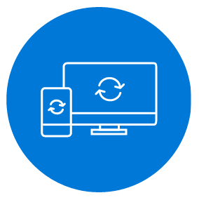


Enable governance through approvals
Connectivity to Microsoft and 3rd party SaaS applications
Microsoft Flow helps non-developers work smarter by automating workflows across apps and services
Get notifications
Synchronize files
Collect data
Automate approvals
Empowers employees to do more
Modernize and extend on-premises applications
Notes:
Microsoft Flow is a SaaS service that helps business users work smarter by automating workflow across a growing number apps & services that they rely on.
The possible workflows span across a wide variety of possibilities, for example :
Get a notifications when a certain file is updated
Synchronize files by connecting your folders to keep data current,
Automatically collect and organize your business data
Streamline approvals and get instant alerts.
Microsoft Flow makes it possible to automate all of these scenarios and more.
Democratizes automation and workflow
Connectivity to Microsoft and 3rd party SaaS applications

Slide 7
Create, run, and manage automated workflows between your favorite apps and services – even when you're on the go!
Create new flows
Grant approvals
Get push notifications
Monitor flow activity
Discover buttons
Use button widgets
Microsoft Flow Mobile & Devices
Work less and do more, from anywhere

Slide 8
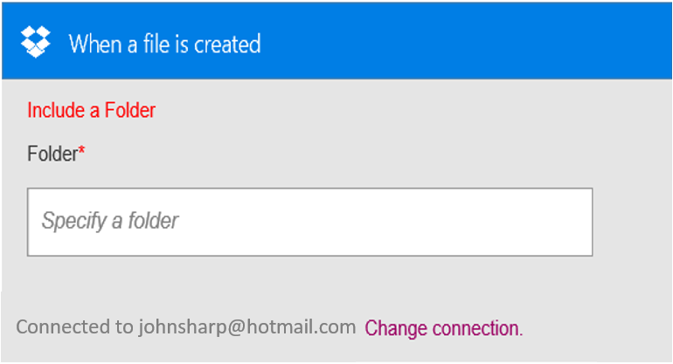
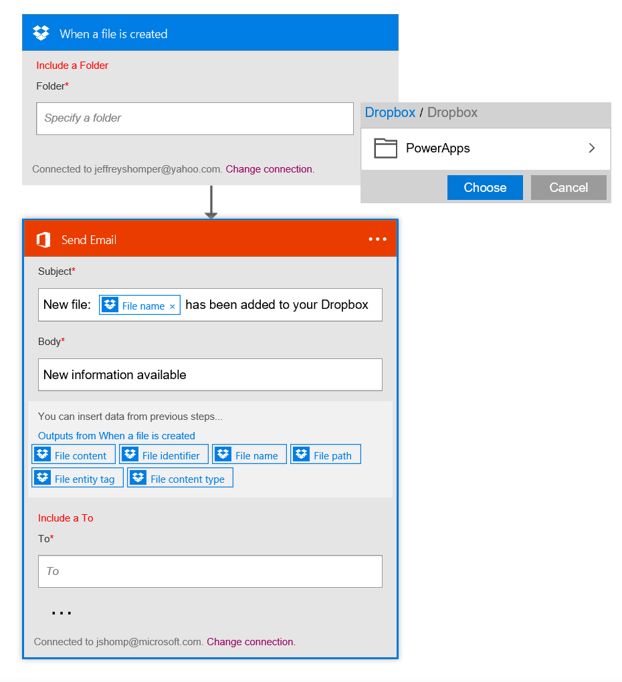
What makes up a flow?
Trigger – the event that kicks off the flow:
manually
on a schedule
on an event in the cloud
Actions – what the flow does
Can use data from the trigger
Now is integrated with Office365

Slide 9
Trigger
Outputs:
File name
Size
File content
Flowing data
Action 1
A binary field would see:
Data ‘flows’ from each step and is available for all later steps
Use Add Dynamic Content to select outputs from previous steps
Certain outputs show up based on the types of the inputs and outputs
File name
Size
File content
Outputs:
Title
Count
Action 2
A string field would see:
A number field would only see:
File name
Size
File content
Count
Title
Size
Count

Slide 10























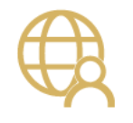




Click-to-code for integrating the systems you’re already using… even custom APIs.
New services being added every week!
https://flow.microsoft.com/manage/connections/available
Notes:
Get a whole bunch of connectors OOTB to common SaaS Services, from O365 (Outlook, OneDrive) to collaborative svcs (Slack) to CRM svcs (Salesforce, Dynamics CRM)
Can support connections to custom APIs (Swagger end point definition)
URL for full list of connectors

Slide 11
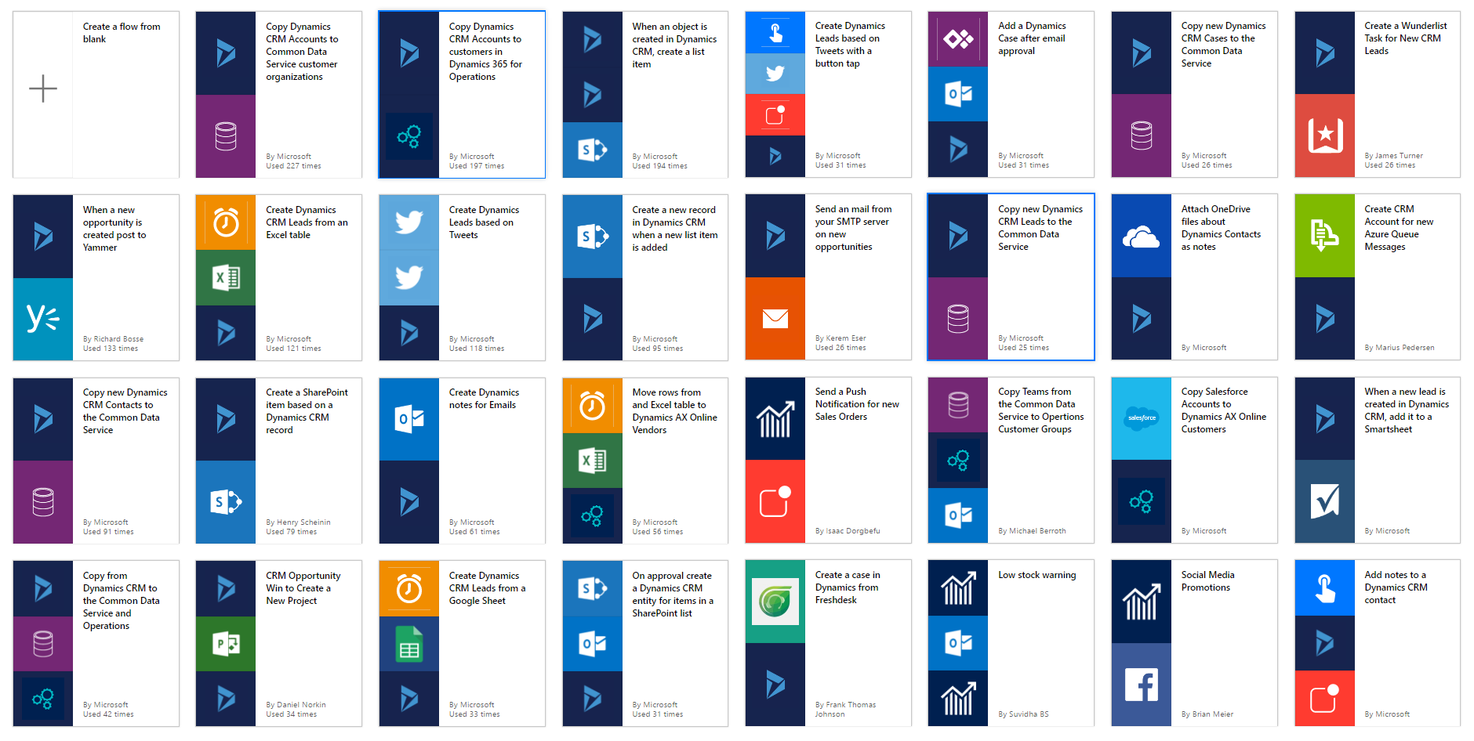
Get started quickly with hundreds useful templates
Notes:
User aver 100+ templates (and growing) for common scenarios as a starting point to create your new workflow!
Various use cases – many of which have been submitted by users like yourselves.

Slide 12
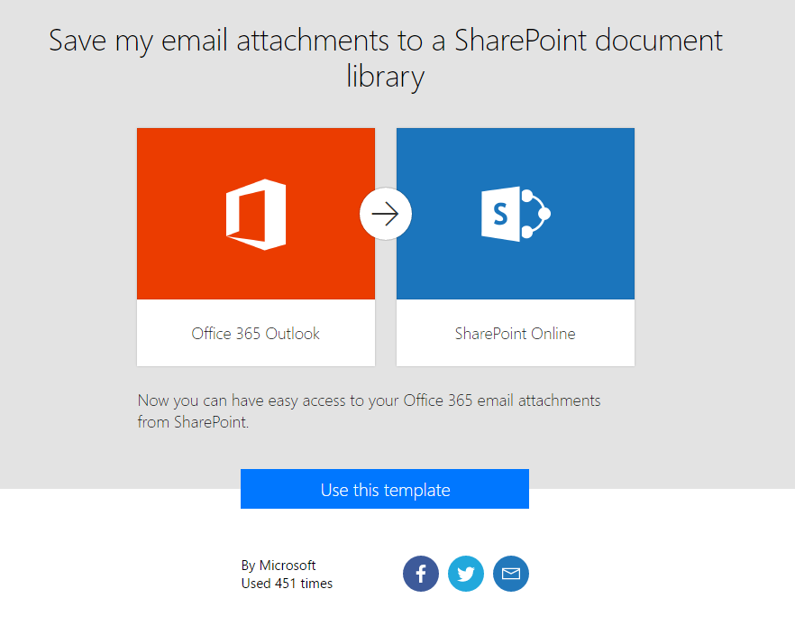
Simple explanation + landing page for templates
Detailed description of what the template does and needs
See how much this template has been used and who published it
Easily share templates via social media or email with your colleagues or friends
Notes:
Microsoft Flow is a SaaS service that helps business users work smarter by automating workflow across a growing number apps & services that they rely on.
The possible workflows span across a wide variety of possibilities, for example :
Get a notifications when a certain file is updated
Synchronize files by connecting your folders to keep data current,
Automatically collect and organize your business data
Streamline approvals and get instant alerts.
Microsoft Flow makes it possible to automate all of these scenarios and more.

Slide 13
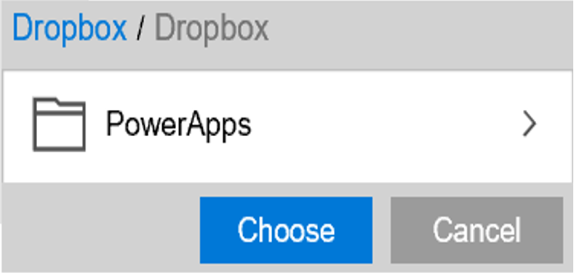
Build your own flow from scratch like a pro integration developer!
Sending an Exchange email when a new file is added in Dropbox
Authenticate to your Dropbox account.
Select folder to monitor
PowerApps
Choose to include properties from previous step (Dropbox file) to improve relevance
Authenticate to your O365 account. Build email Subject and Body
Specify Send To email address and additional properties (optional): From, CC, BCC and Importance
Connected to johnsharp@contoso.com
Notes:
In addition to utilizing Templates, end-users can easily build their own Flows or customize any of the available templates through an easy to use visual designer.

Slide 14
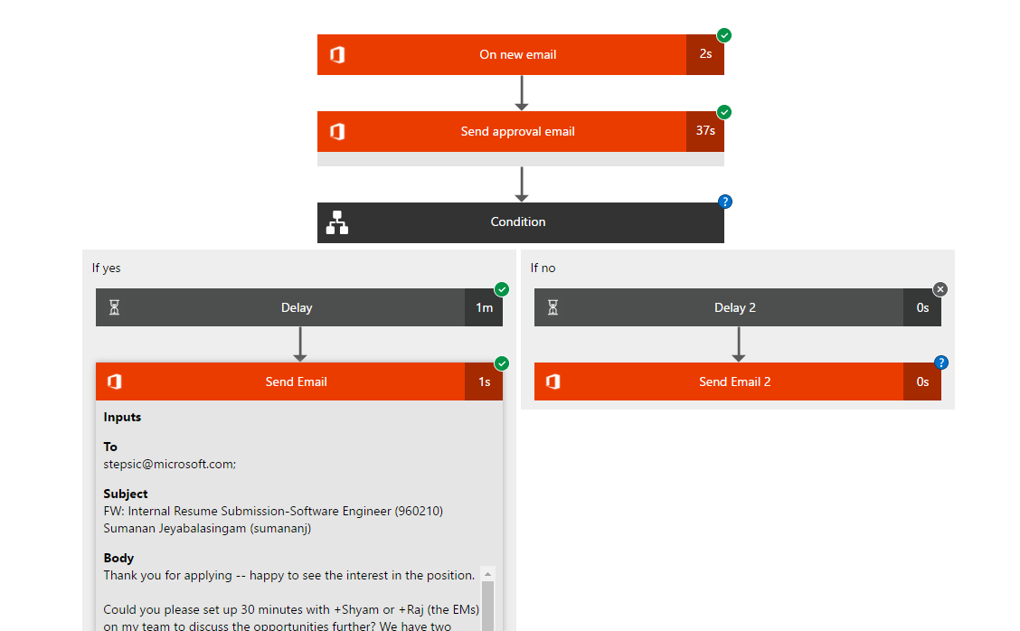
Debug (even real time visual debugging) any flow if needed… make changes and resubmit requests!
Save visual representation as building / creation time
See detailed inputs / outputs for each step

Slide 15
Consolidated list of all connectors in a single location to easily manage them
Same list of connections is shared between PowerApps and Flow so you only have to sign in once
If your password changes or you revoke the application access you can come here to sign-in again and fix it
Delete connections if you no longer want Flow and PowerApps to be able to access that data

Slide 16
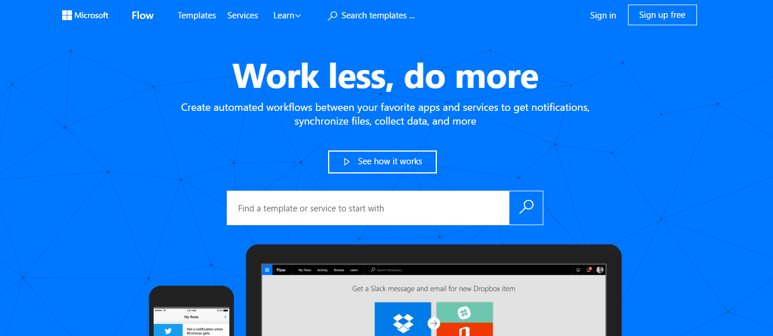
Flow web portal at https://flow.microsoft.com/en-us/
Learn how to use Flow (tutorials and videos) at https://flow.microsoft.com/en-us/guided-learning/
Integrated with Office365
Flow of the Week: https://flow.microsoft.com/en-us/blog/
Twitter
@MicrosoftFlow
@wearsy
Where you manage Flow and how can we get start?
Notes:
If you have access to Office 365 or Dynamics 365 then
You have entitlement to Microsoft Flow
https://flow.Microsoft.com
Feedback
https://aka.ms/flowpa_mvpsummit2018
Twitter
@MicrosoftFlow
@wearsy

Slide 17
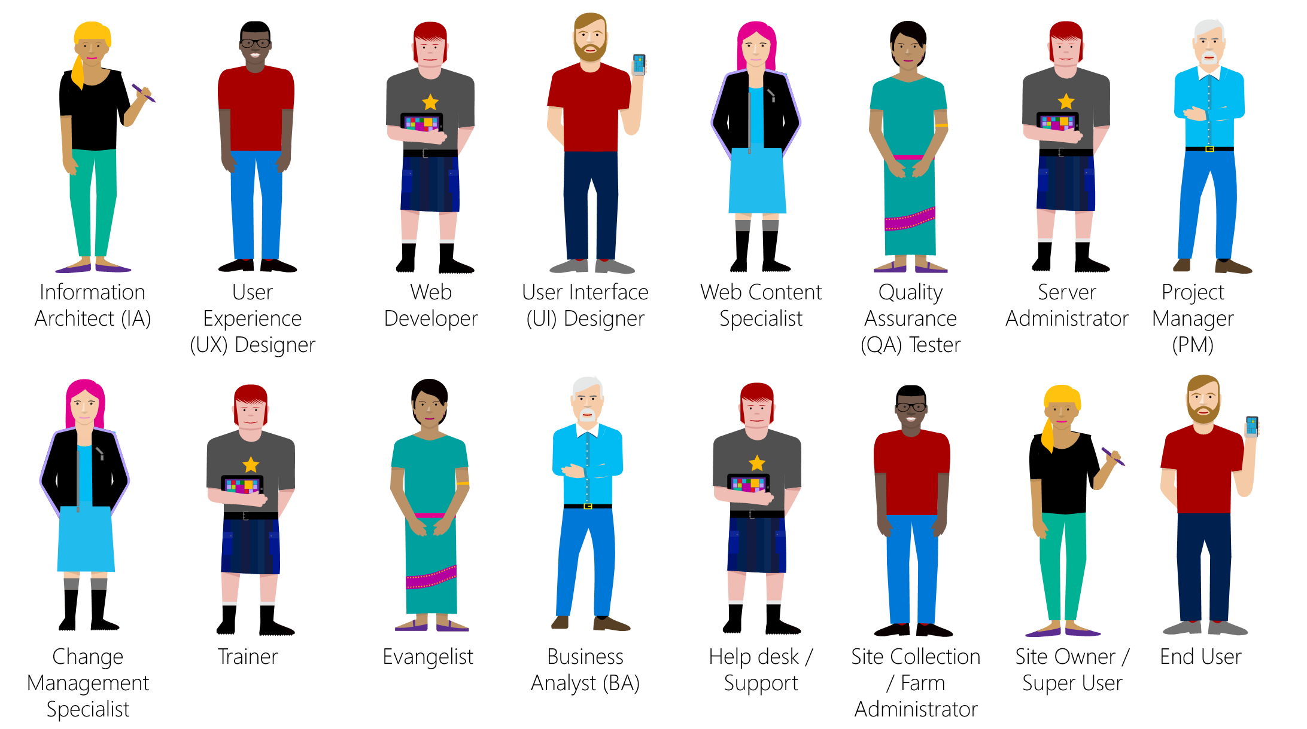
Who is the audience for Flow?
Flow focus: Business Users & Specialists
Volume
BizTalk & Logic Apps focus: IT Pro / Developers
Sophistication

Slide 18

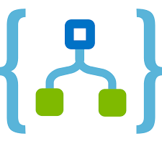
Under the hood, Flow is a Logic App… encapsulating some of its complexity and making it more appealing to Business Users
Any Flow can be converted to a Logic App!
Notes:
Can’t think of a single organisation that does NOT have a need for integration
Integration is a specialised skill
Some integration needs are very simple and/or very common

Slide 19
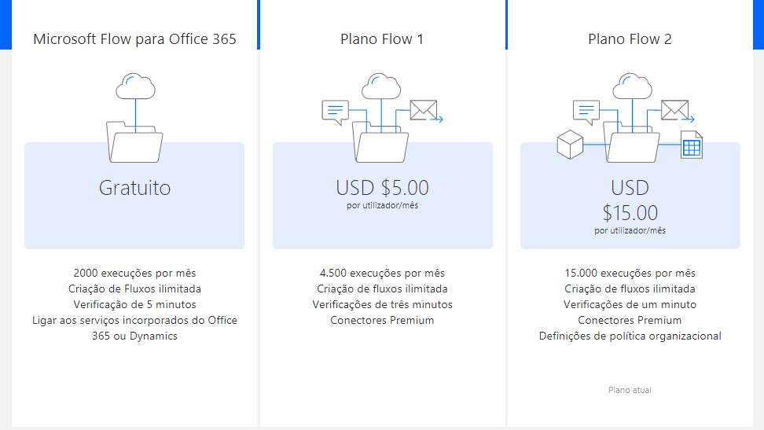

Slide 20

ANY
QUESTIONS
?

Slide 21
Scenarios

Slide 22
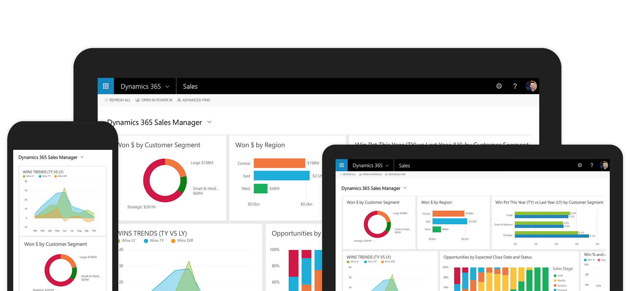
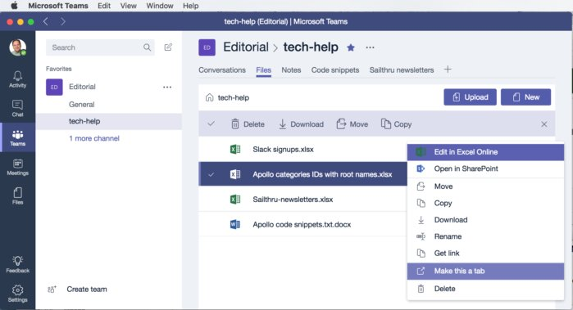

Scenario #1 – Opportunity Notifications
Microsoft Flow
Biz Dev Team
Dynamics 365
Dynamics 365
Trigger
Dynamics 365
Get Account Details
Post Message
Microsoft Teams
Connector

Slide 23



Scenario #2 – Operator Round Inspections
Management Systems
Plant
Management Systems
Microsoft Flow
Flow Button
Images
SharePoint Online
SharePoint Online Connector
Equipment Replacement Request
Approvals
Send Approval
Plant
Engineering
Approval Response
Is
Approved?
No
Yes
Create Case
Management of Change
Dynamics 365
Dynamics 365
Connector
Email

Slide 24
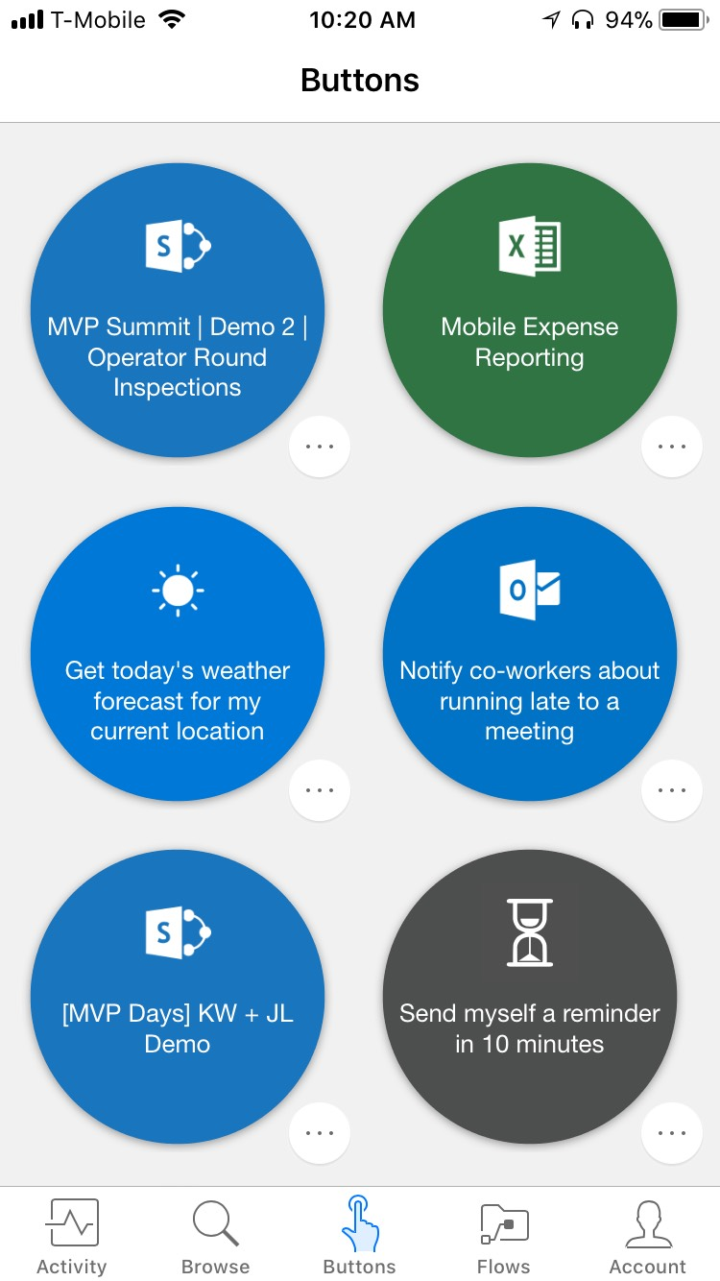
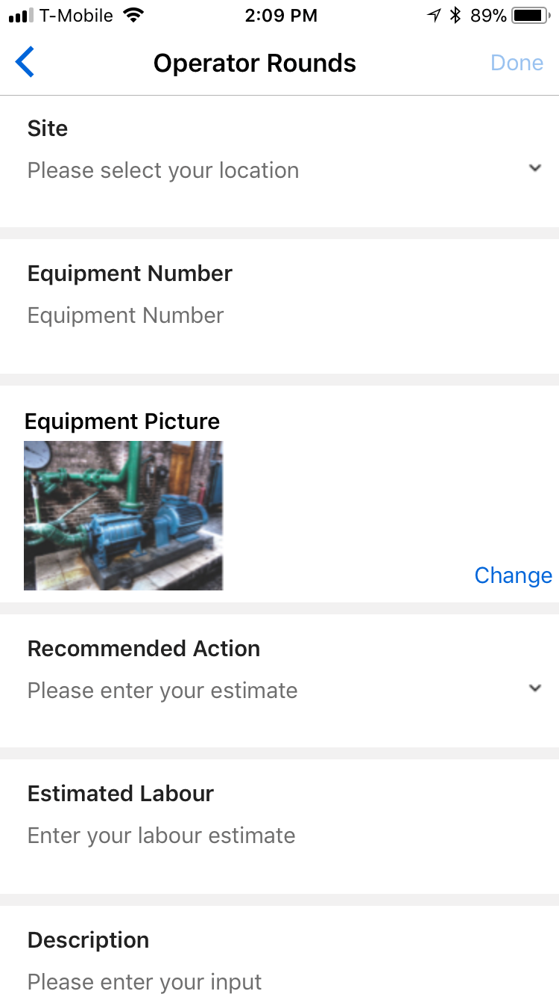
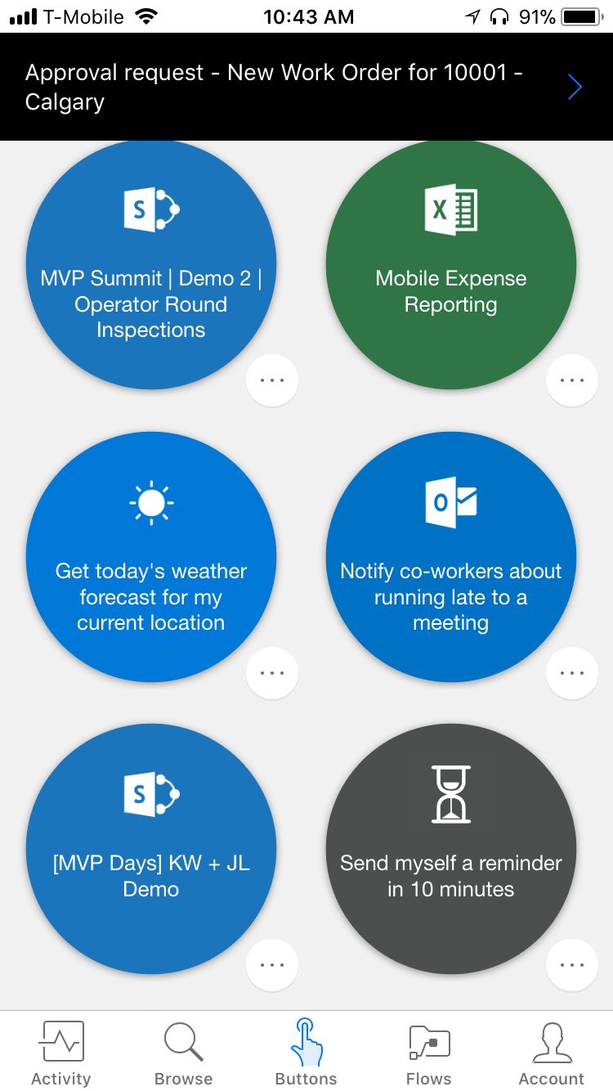
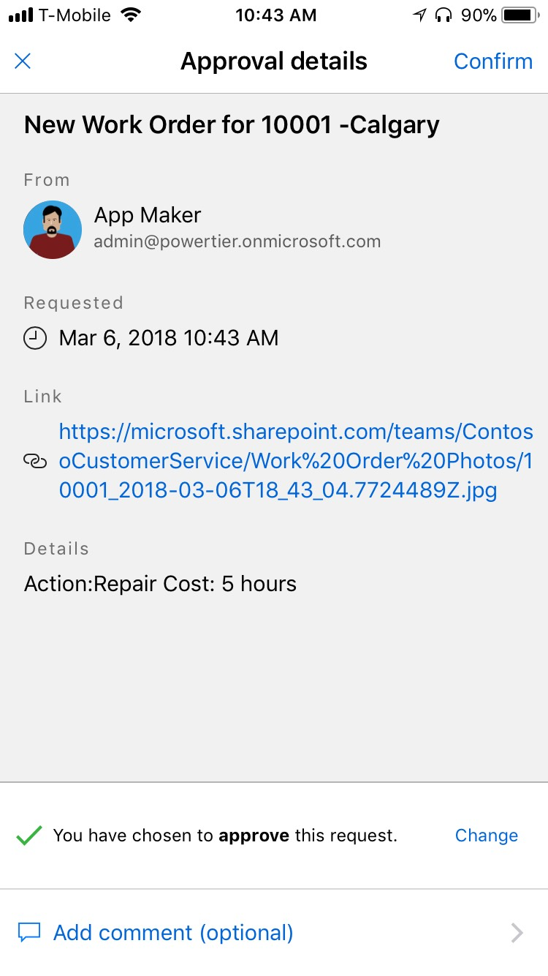
Scenario #2 – Operator Round Inspections

Slide 25
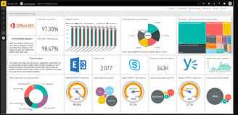
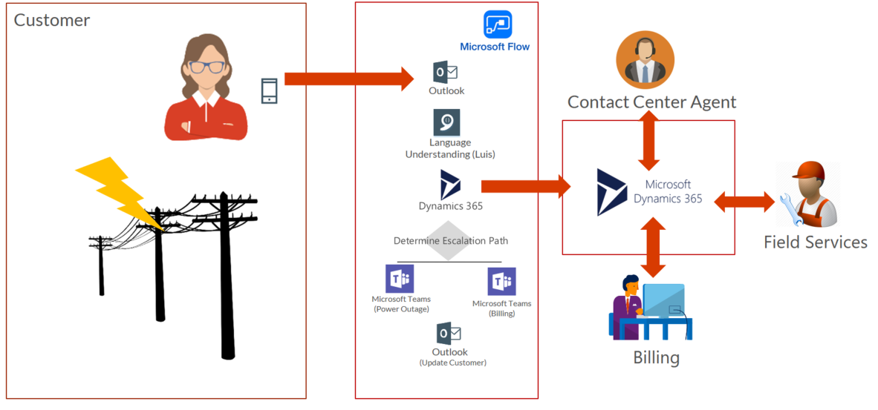

Scenario #3 – Intelligent Customer Service
(our main demo)

Slide 26
Module
4
Hands-on Lab
Microsoft Flow
Create my First Flow
Module
5

Slide 27
Save Outlook Attachments into Drobox
Microsoft Flow
https://docs.microsoft.com/en-us/learn/modules/get-started-with-flow/2-create-first-flow

Slide 28
My Flow Button Notification
Microsoft Flow
https://docs.microsoft.com/en-us/learn/modules/get-started-with-flow/2-create-first-flow

Slide 29
ANY
QUESTIONS
?

